Slide 1


Organizational Behavior
(MGT-502)
Lecture-17

Slide 2
Summary of
Lecture-16

Slide 3
Review Part-I

Slide 4
Basic OB Model
Organization
systems level
Group
level
Individual
level

Slide 5
Today’s Topics

Slide 6
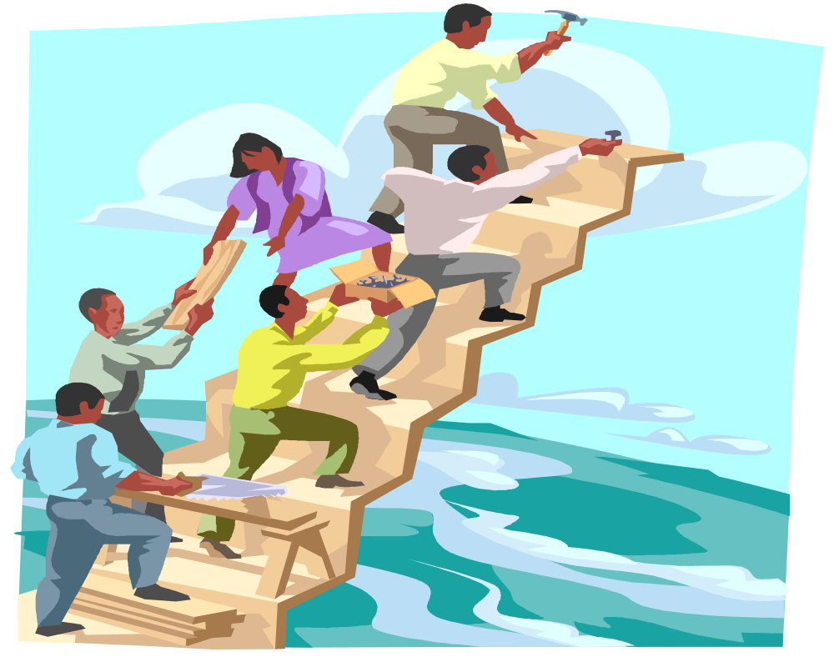
Groups Dynamics

Slide 7
Groups
A group is two or more individuals, interacting and interdependent, who perceive themselves as being a group and have come together to achieve particular objectives.
A group is effective when it satisfies three criteria:
  Production output: the product of the group’s work must meet or exceed standards of quality and quantity
  Member satisfaction: membership in the group must provide people with short-term satisfaction and facilitate their long-term growth and development
  Capacity for continued cooperation: how the group completes a task should maintain or enhance the group’s ability to work together; groups that don’t cooperate cannot survive
Notes:
11/1/01
2

Slide 8
One of the truly remarkable things about work groups/teams is that they can make 2+2=5. Of course, they also have the capability of making 2+2=3.

Slide 9
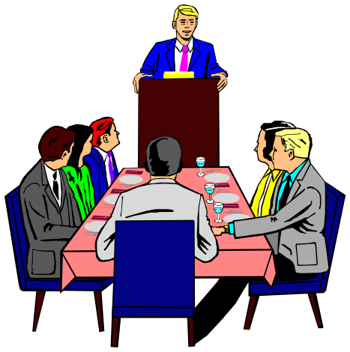
Groups Defined
Two or more individuals interacting with each other in order to accomplish a common goal.

Slide 10
Groups & Teams
Group - two or more people with common interests or objectives
Team - a small number of people with complementary skills who are committed to a common mission, performance goals, and approach for which they hold themselves mutually accountable

Slide 11
Groups versus Teams
All teams are groups
Some groups are just people assembled together
Teams have task interdependence whereas some groups do not (e.g., group of employees enjoying lunch together)

Slide 12
Types of Groups
Formal Groups
Result from the demands and processes of an organization
Designated by the organization as a means to an end
  Command group
    Comprises subordinates reporting directly to a give supervisor
  Task group
    Comprises employees who work together to complete a particular task or project
Informal Groups
Result from natural groupings of people in work environments in response to social needs
Are important for their own sake
  Interest groups
    Comprises workers coming together to achieve a mutual objective
  Friendship groups
    Comprises workers who share something in common

Slide 13
Command Groups
Formal
Task Groups
Interest Groups
Informal
Friendship Groups

Slide 14
Formal Group Leadership
Project
Leader
Supervisor
Foreman
Task Force
Head
Committee
Chair
Department
Manager

Slide 15
Remember...
when individuals are in groups they act differently than when they are alone

Slide 16
Why Do People Join Groups?
Security
Status
Social needs
Power
Goal Achievement
Notes:
11/1/01
3

Slide 17
Stages of Group Development
Forming
Storming
Norming
Performing
Adjorning

Slide 18
Forming stage.
  Initial entry of members to a group.
  Members concern’s include:
    Getting to know each other.
    Discovering what is considered acceptable behavior.
    Determining the group’s real task.
    Defining group rules.

Slide 19
Storming stage.
  A period of high emotionality and tension among group members.
  Members concern’s include:
    Formation of coalitions and cliques.
    Dealing with outside demands.
    Clarifying membership expectations.
    Dealing with obstacles to group goals.
    Understanding members’ interpersonal styles.

Slide 20
Norming stage.
  The point at which the group really begins to come together as a coordinated unit.
  Members concern’s include:
    Holding the group together.
    Dealing with divergent views and criticisms.
    Dealing with a premature sense of accomplishment.

Slide 21
Performing stage.
  Marks the emergence of a mature, organized, and well-functioning group.
  Members deal with complex tasks and handle internal disagreements in creative ways.
  Primary challenge is to continue to improve relationships and performance.

Slide 22
Adjourning stage.
  Particularly important for temporary groups.
  A well-integrated group is:
    Able to disband when its work is finished.
    Willing to work together in the future.

Slide 23
Stages of Group/Team Development
Prestage I
Stage I
Forming
Stage II
Storming
Stage III
Norming
Stage IV
Performing
Stage V
Adjourning

Slide 24
Performing
Norming
Adjourning
Storming
Forming
Return to
Independence
Dependence/
interdependence
Independence

Slide 25
Forming
Storming
Norming
Performing
Individual
Issues
“How do I fit
in?”
“What’s my
role here?”
“What do the
others expect
me to do?”
“How can I best
perform my
role?”
Group
Issues
“Why are we
here?”
“Why are we
fighting over
who’s in
charge and who
does what?”
“Can we agree
on roles and
work as a
team?”
“Can we do the
job properly?”

Slide 26
Group Task
The more complex the task, the more it is non-routine and requires a range of skills,
the more important group process becomes!

Slide 27
Group Productivity
People can be more productive when working in groups than when working alone, if the obstacles to group productivity are avoided.
Synergy is a biological term referring to an action of two or more substances that results in an effect that is more than the mere summation of the individual substances; the whole is more than the sum of its parts (2 + 2 = 5).
Process loss is the difference between what is actually produced by a group and what could have been produced by the group when you consider its inputs (2 + 2 = 3).
Notes:
11/1/01
8

Slide 28
Example of Synergy
The social facilitation effect can either enhance group productivity (synergy) or restrict it (process loss):
  The performance of simple, routine tasks tends to be speeded up and improved by the presence of other people (synergy)
  When tasks are complex and require closer attention, the presence of other people will hurt performance (process loss)
Notes:
11/1/01
10

Slide 29
Process Losses
Production blocking occurs when people get in each other’s way as they try to perform a task
Group-maintenance roles must be filled in order to smooth group relations, but these roles divert time and effort from producing and thus cause process loss
Social loafing or free riding occurs when a group member decides to loaf, hoping that someone else will pick up the slack (usually occurs when group rewards are shared equally, without regard to individual performance)
Notes:
11/1/01
11

Slide 30

Social Loafing
The tendency to withhold physical or intellectual effort when performing a group task.

Slide 31
To Reduce Social Loafing
Make individual contributions identifiable
Make individuals feel that they are making valuable contributions to a group
Keep group as small as possible
Notes:
4
5

Slide 32
Effects of Group Processes
Potential group
effectiveness
+
Synergy
-
Process
losses
=
Actual group
effectiveness
Notes:
11/1/01
9

Slide 33
Group Roles
Task-Oriented
Roles:
Initiators
Information Seekers
Opinion Givers
Energizers
Relations-
Oriented Roles:
Harmonizers
Compromisers
Encouragers
Expediters
+
Task
Performance
+
-
Self-Oriented
Roles:
Blockers
Recognition Seekers
Dominators
Avoiders

Slide 34
Work Group Behavior
Affected by:
  External conditions
  Group member resources
  Group structure
  Group processes
  Group task

Slide 35
External Conditions
Imposed on the Group
Overall strategy
Authority structures
Formal regulations
Resources
Employee selection
Evaluation-rewards
Culture
Work setting

Slide 36
Group Members Resources
Knowledge and Skill
Abilities
Personality
REQUISITE VARIETY--diversity slows decision-making but it can create more creative and higher quality outcomes!

Slide 37
Group Structure
Groups are not unorganized mobs.
They have structure that shapes the member behavior

Slide 38
Group Structure
Formal Leadership
Roles
Norms
Status
Size
Composition
Cohesiveness
Rules

Slide 39
Group Structure
Size--”size of the group.”
Norms--”acceptable standards of behavior shared by members.”
Cohesiveness--”degree to which members are attracted to each other and desire to maintain in group.”

Slide 40
Requirements
Group
Tasks
Complexity
Interdependence

Slide 41
Factors That Contribute to Group Cohesiveness
Group Size
Similarity/Diversity of Group Members
Competition with Other Groups
Success
Exclusiveness
Notes:
12
17

Slide 42
Relationship Between Cohesiveness, Norms, & Productivity
Cohesiveness
High Low
High
Low
High
productivity
Moderate
productivity
Performance Norms
Low
productivity
Moderate to
low productivity

Slide 43
Group Size
Smaller Groups better at task completion
Larger Groups better at collecting information and complex problem solving

Slide 44
Accuracy
Creativity
Group Effectiveness
and Efficiency
Speed
Acceptance

Slide 45
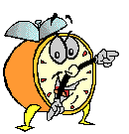
Let’s stop it here

Slide 46
Summary

Slide 47
Groups Defined
Two or more individuals interacting with each other in order to accomplish a common goal.

Slide 48
Stages of Group Development
Forming
Storming
Norming
Performing
Adjorning

Slide 49
Group Roles
Task-Oriented
Roles:
Initiators
Information Seekers
Opinion Givers
Energizers
Relations-
Oriented Roles:
Harmonizers
Compromisers
Encouragers
Expediters
+
Task
Performance
+
-
Self-Oriented
Roles:
Blockers
Recognition Seekers
Dominators
Avoiders

Slide 50
Relationship Between Cohesiveness, Norms, & Productivity
Cohesiveness
High Low
High
Low
High
productivity
Moderate
productivity
Performance Norms
Low
productivity
Moderate to
low productivity

Slide 51
Next….

Slide 52


Teams

Slide 53
Organizational Behavior
(MGT-502)
Lecture-17

